Slide 1
Study Unit 5 Data Analytics in Python

Slide 2
Introduction to Scikit-Learn

Slide 3
Scikit-Learn
It is common to use Python to carry out tasks for data analytics, statistical modelling or machine learning recently.
One of the most common libraries used for these purposes is scikit-learn, a free machine learning library written for Python.
Scikit-learn features various algorithms such as classification, regression, clustering, etc.
In machine learning, programs are constructed with parameters such that they can “learn” from newly fed data.
Programs can automatically adjust and improve their behaviour according to the new “knowledge”.

Slide 4
Algorithms in Scikit-Learn
Here are some common algorithms available in scikit-learn:
Supervised learning
Linear Models | Gaussian Processes
Discriminant Analysis | Cross decomposition
Kernel ridge regression | Decision Trees
Support Vector Machines | Isotonic regression
Nearest Neighbours | Neural network models (supervised)
Unsupervised learning
Gaussian mixture models | Novelty and Outlier Detection
Clustering | Density Estimation
Covariance estimation | Neural network models (unsupervised)

Slide 5
Install and Import Scikit-Learn
Use the import syntax to load scikit-learn into the program.
It is sklearn and not scikit-learn that refers to the scikit-learn library.
import sklearn

Slide 6
Import Algorithms from Scikit-Learn
Since the library is extensive, programmers usually only load the required algorithm or only its “estimator” object.
For instance, if linear regression models are required, import the estimator LinearRegression from the module linear_model by:
It is not unusual to load multiple algorithms for one analytics task.
Put sufficient comments in the program to explain the purpose and use of each imported module.
from sklearn.linear_model import LinearRegression

Slide 7
Activity
Import the following algorithms of scikit-learn into your JupyterLab notebook:
train_test_split
metrics
pre-processing
tree
Module “KMeans” from “cluster”
Module “PCA” from “decomposition”

Slide 8
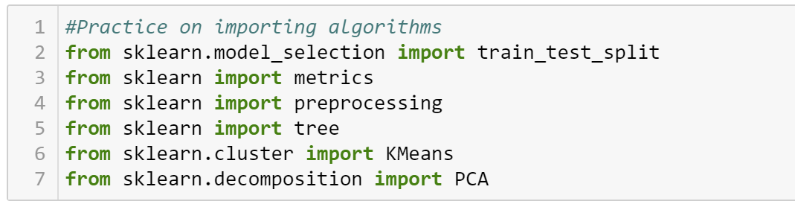
Activity (Answers)
Import the following algorithms of scikit-learn into your JupyterLab notebook:
train_test_split
metrics
pre-processing
tree
Module “KMeans” from “cluster”
Module “PCA” from “decomposition”
Notes:
Okay, so maybe we have some practice first. May I ask for your help to import the following algorithms of scikit-learn into your Jupyter Notebook or Jupyter Lab?
Let me give you some very small hints here. For the first one train_test_split here, you also cannot directly import it from sklearn, you need to go to import train_test_split from a model_selection function.

Slide 9
Discussion
What is the difference between supervised and unsupervised machine learning?

Slide 10
Discussion (answers)
What is the difference between supervised and unsupervised machine learning?
Supervised: has a target; unsupervised: no target

Slide 11
Data Preparation for Analytics Algorithms

Slide 12
Reduce Number of Categories
Categorical variables may need to be treated in data analytics.
Usually, they are converted to dummy variables required by some algorithms.
Example: Weight of {Normal, Overweight, Obese} can become two dummy variables of Overweight with either 0 or 1; and Obese with either 0 or 1. Here, 0 means No, 1 means Yes.
Sometimes to reduce the number of categories to simplify the problem.
Example: Grade {Fail, Subpass, Pass} can become {Fail, Pass}
In Python, we can replace category labels by the .replace() method:
DataFrame_Name["column_label"].replace(to_replace, value)

Slide 13
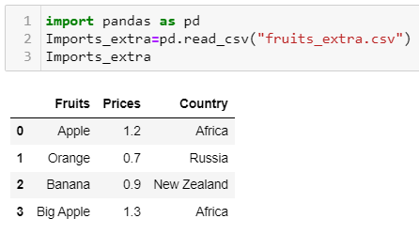
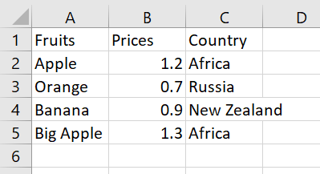
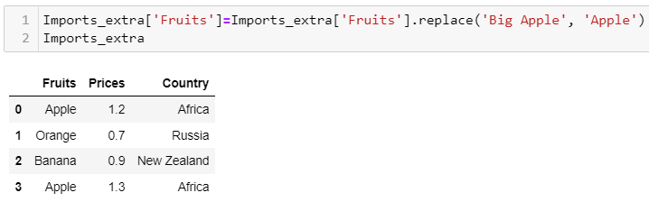
Example of Reducing Categories
Grade {Big Apple, Apple} can become {Apple}
.csv file
Notes:
You can use this path as long as your code and the csv file are located in the same folder.

Slide 14
Rename Variables
Use the .rename() method to rename the variables in a DataFrame.
The column labels to be renamed must be put as keys of a dictionary.
The values of the dictionary will be the new labels of the corresponding columns.
DF_Name.rename(columns = {"oldvar": "newvar"})

Slide 15
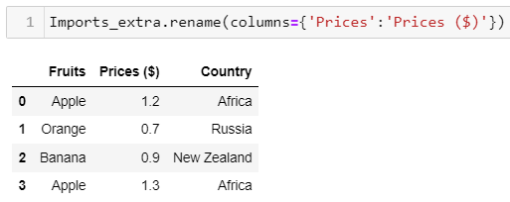
Example of Renaming Variables
Rename the column ‘Prices’
Notes:
You can use this path as long as your code and the csv file are located in the same folder.

Slide 16
Create Dummy Variables
Categorical variables must be converted to dummy variables before included in the scikit-learn algorithms.
Dummy variables only have two values: 0 and 1.
If an observation belongs to a certain category, the corresponding dummy variable will be 1, otherwise 0.
Use get_dummies() to convert categorical variables to dummy variables.
DF_name = pd.get_dummies(data, drop_first)

Slide 17
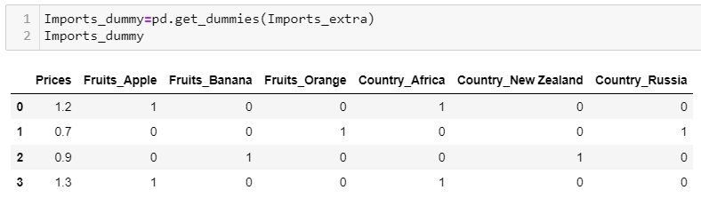
Example of Dummy Variables
Dummy variable conversion
Notes:
You can use this path as long as your code and the csv file are located in the same folder.

Slide 18
Extract Dependent and Independent Variables (I)
In scikit-learn, the ultimate command of many algorithms is to fit a model by the .fit() function which has two parameters: X and Y.
The parameter X is the design matrix containing all independent variables.
The parameter Y is the vector of the target variable.
Both X and Y can be NumPy arrays or pandas DataFrames.
We need to extract X and Y from the original DataFrame.

Slide 19
Extract Dependent and Independent Variables (II)
Select the column representing Y and save it as a new object.
Subset the matrix of X from the DataFrame in similar manner.
If the DataFrame only contains the independent and target variables, just drop the target variable from the original DataFrame to obtain X.
y = DataFrame_name["target_var"]
X = DataFrame_name[["X1", "X2", …]]
X = DataFrame_name.drop("target_var",axis=1)

Slide 20
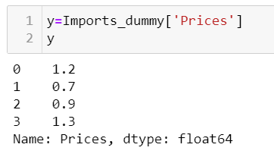
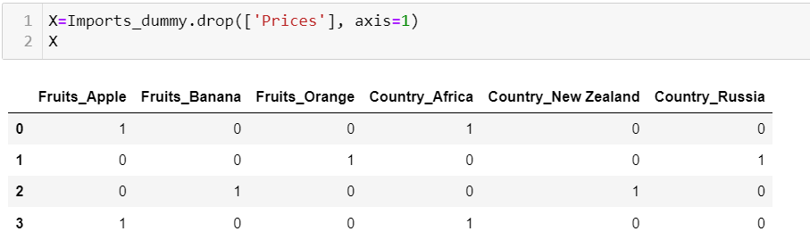
Example of Dependent and Independent Variables
Suppose (1) ‘Prices’ is the target variable; (2) All other columns are independent variables.
Notes:
You can use this path as long as your code and the csv file are located in the same folder.

Slide 21
Other Data Preparation techniques
Purpose | Common treatment | Comment
Treat missing values | Remove the records with missing values; replace the missing values | Please refer to SU4 for more details.
Treat outliers | Remove the outliers | Please refer to SU4 for more details.

Slide 22
Other Data Preparation techniques (Cont’d)
Purpose | Common treatment | Comment
Treat categorical values | Create dummy variables, one-hot encoding | Need to be treated in algorithms that can only process numerical variables. For example, age categories of {infant, young, adult, elderly} are converted into three dummy variables. Young = {0, 1}, Adult = {0, 1}, Elderly = {0, 1}. And when these three variables are all zeros, it implies Infant.
Treat numerical values | Discretisation or binning | To convert one numeric variable (e.g., age) to categorical values of {infant, young, adult, elderly}

Slide 23
Other Data Preparation techniques (Cont’d)
Purpose | Common treatment | Comment
Normalisation/standardisation | Scaling/transforming variables | Convert data into a standard scale for easy comparison and interpretation. Useful when the data has different units of measurement or scales.

Slide 24
Activity
Car sales program:
Carry out the following tasks in JupyterLab:
Since there are many car models (especially their names are complicated and not comparable with each other) in the market, it is rather more important to include “Category” than “Model” in our analysis later.
Remove “Model” from the DataFrame.
Please define and show the independent variables (“Year” and “Make”) and dependent variables (“Category”) in the dataset.
car_model.csv

Slide 25
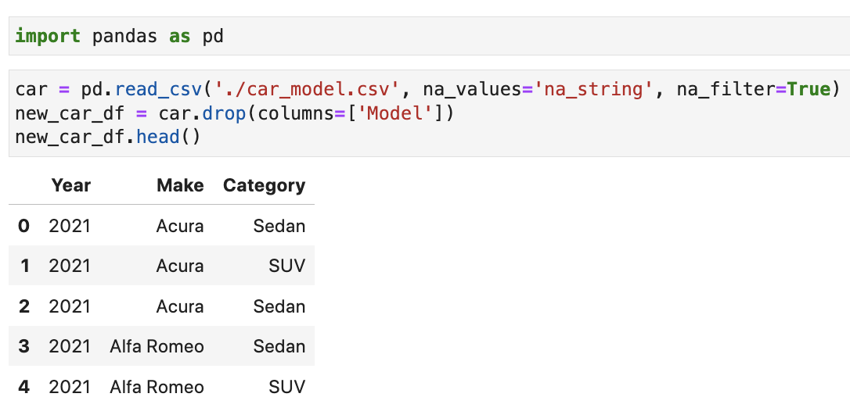
Activity (Answers)

Slide 26
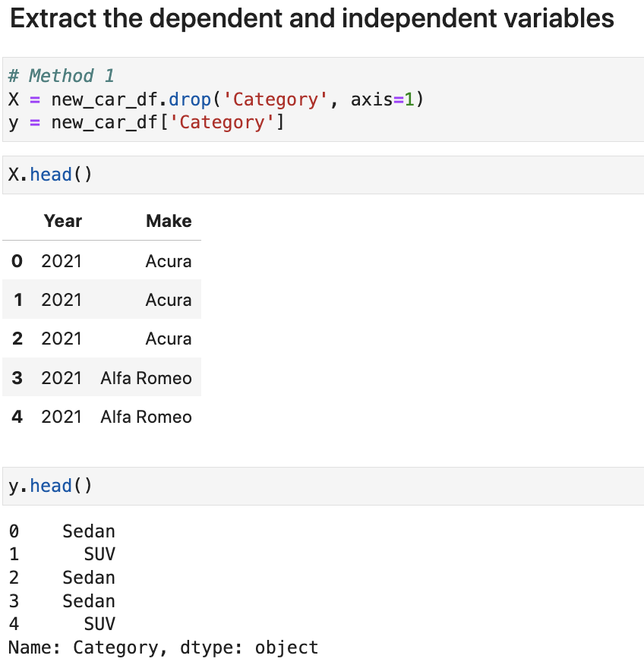
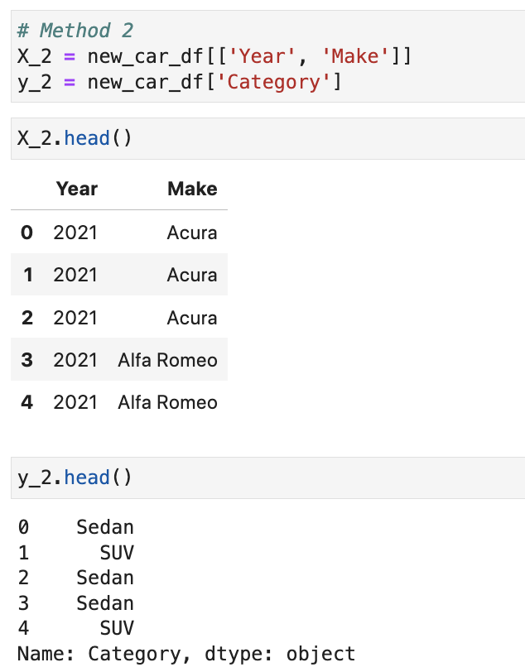
Activity (Answers)

Slide 27
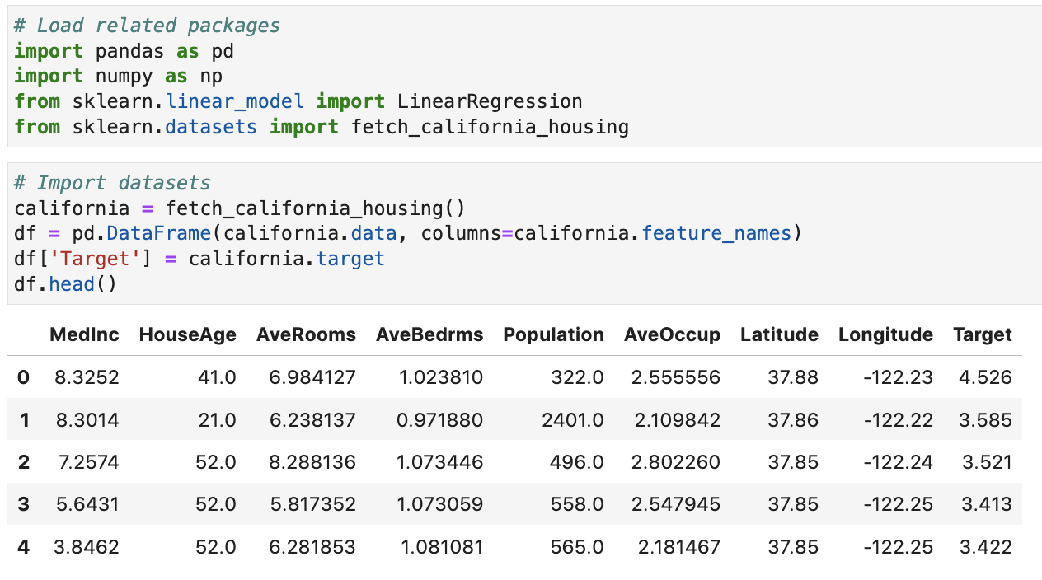
Activity
SU5 Regression Example
Build a linear regression model to analyse the relationship between the target variable ‘Target’ and the independent variables (all other variables).
Load the packages and dataset:

Slide 28
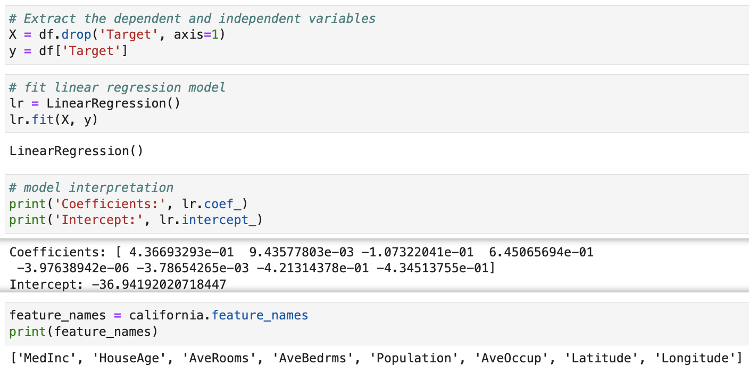
Activity (Answers)

Slide 29
Clustering

Slide 30
Introduction to K-Means Clustering
One of the most popular clustering algorithms is the K-Means method.
This technique is very efficient in clustering large data sets.
The algorithm here is to split the data into K groups with equal variance by minimising the variation within the cluster (inertia).
The K-Means method requires the number of clusters to be specified before the algorithm starts.
The clusters are characterised by their centroids (means), the centre of an area in a two-dimensional space.
The K different means should be explored during the clustering process.

Slide 31
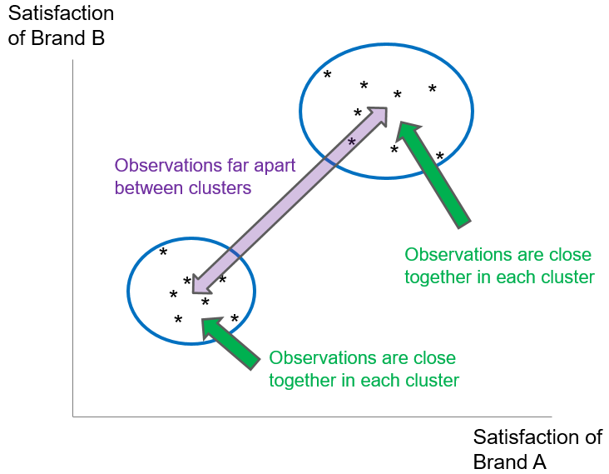
Intuition of K-Means Clustering
We want members in a cluster to be ‘close’ to each other, and clusters to be far apart from each other.

Slide 32
K-Means Clustering Process
The process of K-Means clustering contains five main steps:
Select K observations randomly as initial cluster centroids.
Compute the distance of each object to the centroid.
Assign each object to the nearest centroid based on the distance computed. Objects assigned to the same centroid form a cluster.
Recompute the centroid for each cluster using the objects in it. Restart iteration from Step 2.
Iteration stops when the centroids remain unchanged, or a specified number of iterations has been performed.

Slide 33
K-Means Properties
The Euclidean distance is preferred in general when computing the distance between an object to the centroids.
The Euclidean distance is measured by the sum of the squared differences between the values of some selected clustering criteria.
After the clustering process, ensure the insights created by the resulting clusters. A good clustering solution allows clear description of the cluster profile.
Evaluate the quality of clustering solutions by cohesion, separation and parsimony.

Slide 34
Fitting K-Means Clustering by Scikit-Learn
In scikit-learn, all algorithms are controlled and executed by the estimator.
Adjust the parameters for the modelling process in the syntax of the estimator declaration.
In K-Means Clustering, the estimator is called KMeans. And it can be imported from the cluster module of the scikit-learn package.
Initiate the KMeans estimator first and adjust the estimation parameters according to the individual needs.
from sklearn.cluster import KMeans
km_Object = KMeans(n_clusters = 8, init = "k-means++", n_init = 10, max_iter = 300, tol = 0.0001, precompute_distances = "auto", random_state = None)
(Source: https://scikit-learn.org/stable/modules/generated/sklearn.cluster.KMeans. ‌html)

Slide 35
Fit K-Means Clustering
Perform K-Means clustering using the KMeans estimator.
X is a prepared DataFrame based on which the clusters are constructed.
With sample_weight we can pre-specify the weights for each observation in X. If it is set to None, all observations will be assigned equal weight.
The fitted estimator of the K-Means algorithm is saved in km_fit_Object.
km_fit_Object = km_Object.fit(X, sample_weight = None)

Slide 36
Obtain the Clusters
To obtain and view the clusters of each data point, we can use the following syntax:
X contains the data for which the cluster prediction is calculated.
Print(km_fit_Object.labels_)

Slide 37
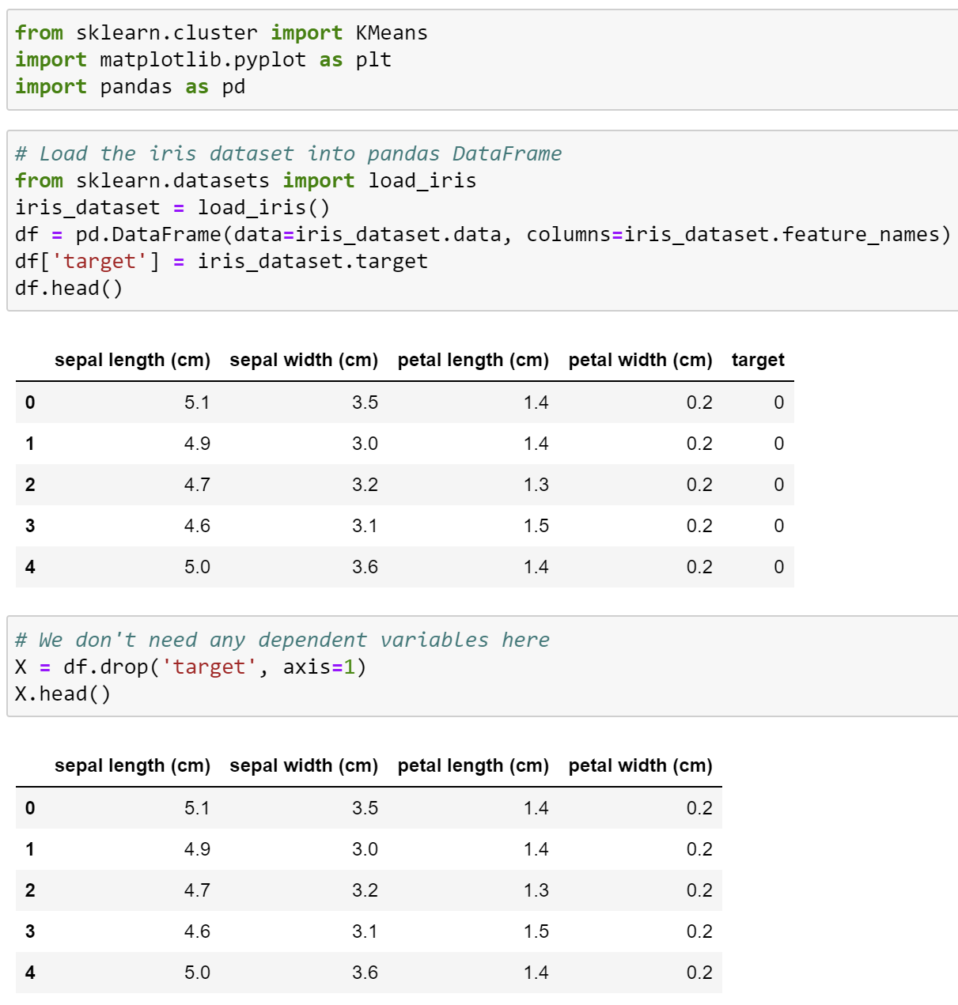
Activity
Use K-Means Clustering to Analyse Iris dataset:

Slide 38
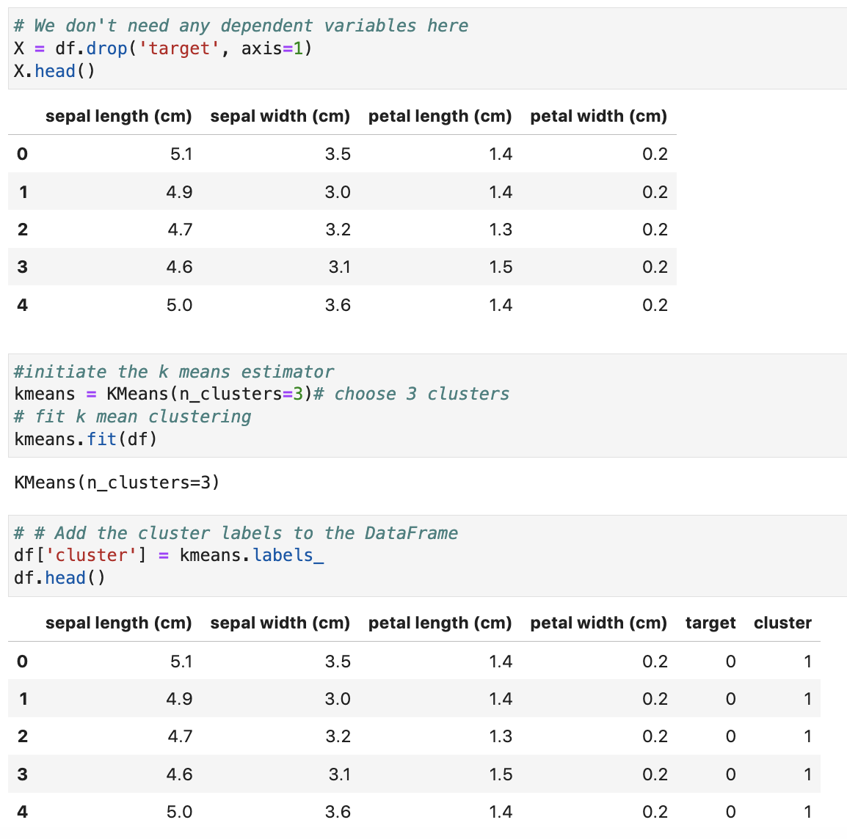
Activity (Answers)

Slide 39
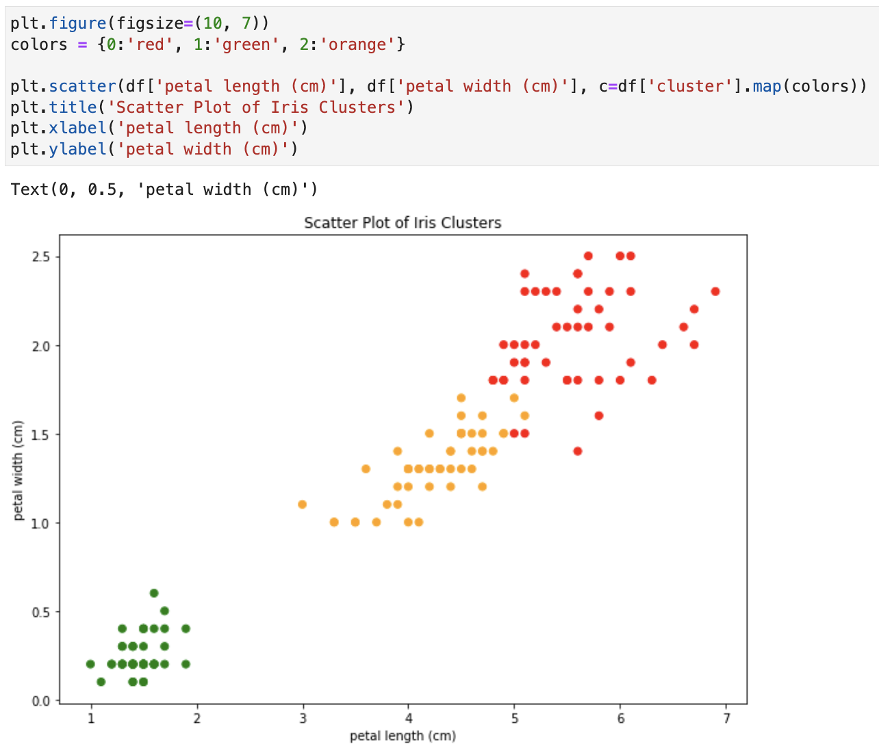
Activity (Answers)

Slide 40
Decision Trees

Slide 41
Introduction to Decision Trees (I)
Decision trees split a sample to reach certain decision points based on some criteria. It is therefore a sample classification technique.
Each decision point is called a node and represents a subset of the sample.
Nodes split from a superordinate node are called the child node while the origin node is called the parent node.
A child node with no further subdivisions or splitting is called a leaf node.
The decision tree algorithm predicts the individual classification based on the input variables and the value of the target variable at the same time.
These rules of decision form the resulting model which can be illustrated by a tree-like structure graphically.

Slide 42
Introduction to Decision Trees (II)
Decision tree model illustrates the complex relationship between the target variable and the input variables rather well.
The importance of the input variables in the decision rules is reflected in the decision tree. Higher up variables are more important.
The value of a leaf node is the prediction of the target variable for those observations classified in it.
If the target variable is categorical, the predicted value will be the mode. If it is numeric, the value will be the mean.

Slide 43
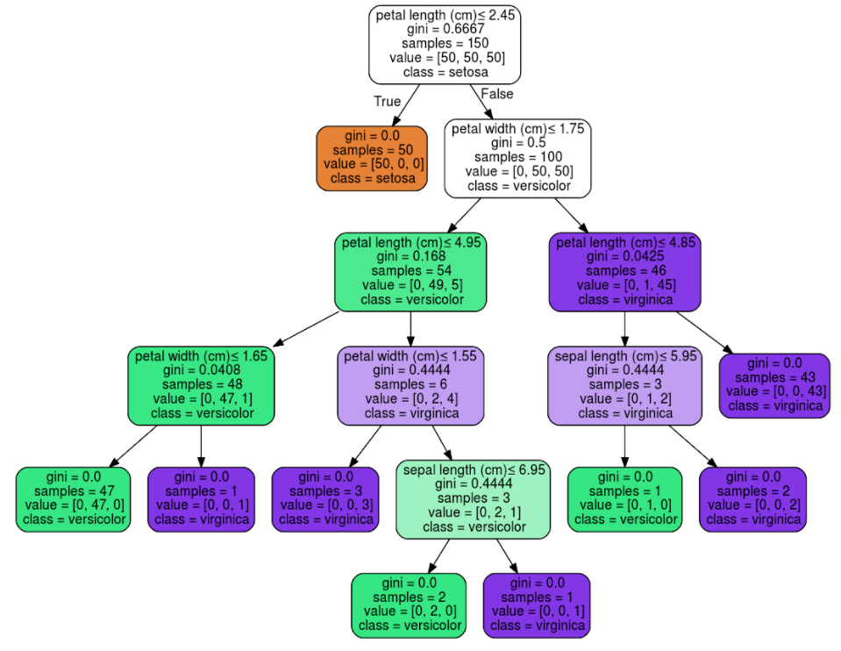
Example of Decision Tree
Source: https://scikit-learn.org/stable/modules/tree.html
Root node; the most important feature
In total, we have 9 leaf nodes (nodes in the red rectangles)

Slide 44
Algorithm of Constructing Decision Trees (I)
The most common algorithms for constructing decision trees are CHAID (chi-square automatic interaction detection), C5.0 (a proprietary algorithm) and CART (classification and regression tree).
The estimators DecisionTreeClassifier and DecisionTree-Regressor of scikit-learn use an optimised version of CART.
The CART algorithm can create classification and regression trees.
Regression trees estimate values of continuous target variables, while classification trees predict outcomes of categorical target variables.
CART splits the tree into two sub-samples at every decision point based on the input variables.
The splitting process terminates once certain stopping criteria are fulfilled.

Slide 45
Algorithm of Constructing Decision Trees (II)
The sample subset at each node become more homogeneous as the split process advances.
The homogeneity of each subset reflects the split quality from a parent node to its child nodes.
In classification tree, the homogeneity is measured by Gini and Entropy.
In regression tree, the impurity is measured by the sum of squared error (SSE).
In both options, the split with the highest reduction of impurity or highest homogeneity in the child nodes will be chosen.

Slide 46
Algorithm of Constructing Decision Trees (III)
Two possibilities to stop the CART algorithm:
no or little improvement of impurity detected after a new split
Gini/SSE drops below a threshold
Low Gini or SSE indicates rather homogeneous nodes, another split would not decrease the impurity significantly.
High thresholds: oversimplified trees. Low thresholds: overcomplicated trees.
a pre-specified depth (number of splits) of the tree is reached
control tree size without oversimplifying or overcomplicating it.
Set a lower bound of observations in the nodes.

Slide 47
Decision Tree Estimators (I)
Import the sklearn.tree module in the first place.
Initiate the DecisionTreeClassifier estimator for classification tree:
To fit a regression tree, declare the DecisionTreeRegressor estimator.
“…” indicates the parameters of the estimator that control the fitting of the decision trees.
from sklearn import tree
tree_Object = tree.DecisionTreeClassifier(…)
tree_Object = tree.DecisionTreeRegressor(…)

Slide 48
Decision Tree Estimators (II)
Here is a list of the parameters of the DecisionTreeClassifier and DecisionTreeRegressor estimators.
The main differences between them are the parameter criterion and the availability of the parameter class_weight.
(Source: https://scikit-learn.org/stable/modules/generated/sklearn.tree.DecisionTreeClassifier.html, https://scikit-learn.org/stable/modules/generated/sklearn.tree.DecisionTreeRegressor.html)
Parameter | Value Type
criterion (Default: "gini" for classification, "mse" for regression) | Classification: "gini", "entropy" Regression: "mse", "friedman_mse", "mae", "poisson"
splitter (Default: "best") | "best", "random"
max_depth (Default: None) | Integer
min_samples_split (Default: 2) | Integer or float
min_samples_leaf (Default: 1) | Integer or float

Slide 49
Fit Decision Trees
Fit decision trees on a prepared training DataFrames by .fit().
The .fit() method applies to both DecisionTreeClassifier and DecisionTreeRegressor.
tree_fit_Object = tree_Object.fit(X, y, sample_weight = None)

Slide 50
Plot Decision Trees (I)
Decision tree plot is an important tool to understand and to evaluate its performance.
The plot can be generated by the plot_tree() function of the tree module conveniently.
The plot_tree() function can also be combined with the matplotlib options to optimise the output of the tree.
tree.plot_tree(decision_tree, max_depth = None, feature_names = None, class_names = None, label = "all", filled = False, impurity = True, node_ids = False, proportion = False, rounded = False, precision = 3, ax = None, fontsize = None)

Slide 51
Plot Decision Trees (II)
Here is a list of the parameters of the plot_tree() function.
(Source: https://scikit-learn.org/stable/modules/generated/sklearn.tree.plot_tree.html)
Parameter | Value Type
decision_tree (No default value) | Decision tree object
max_depth (Default: None) | Integer
feature_names (Default: None) | List of strings
class_names (Default: None) | List of strings or Boolean
label (Default: "all") | "all", "root", "none"
filled (Default: False) | Boolean
impurity (Default: True) | Boolean

Slide 52
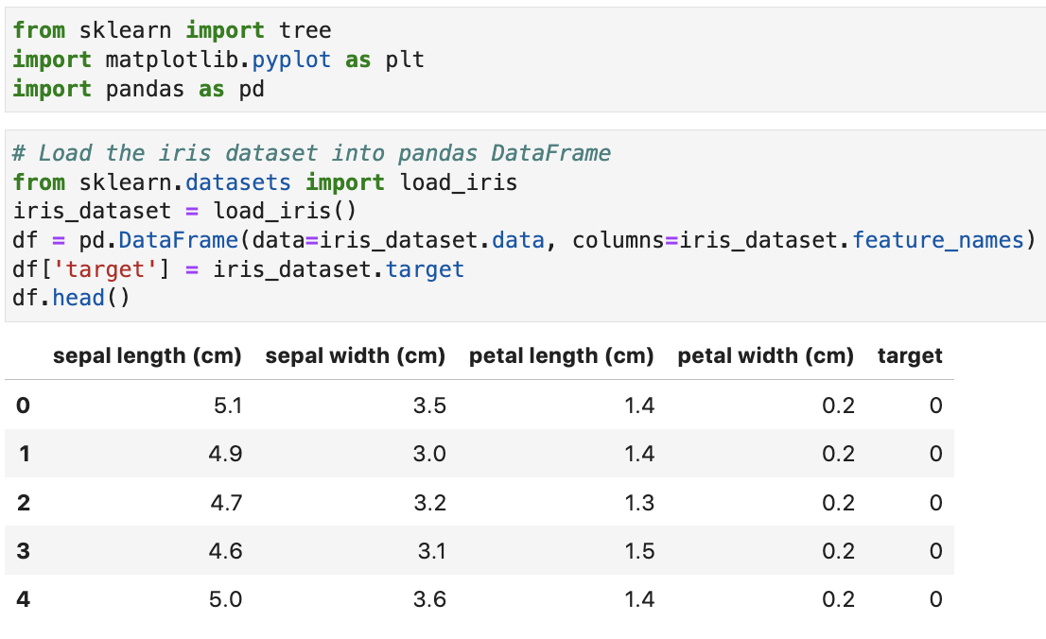
Activity
Use Decision Tree to Analyse Iris dataset (target variable is ‘target’):

Slide 53
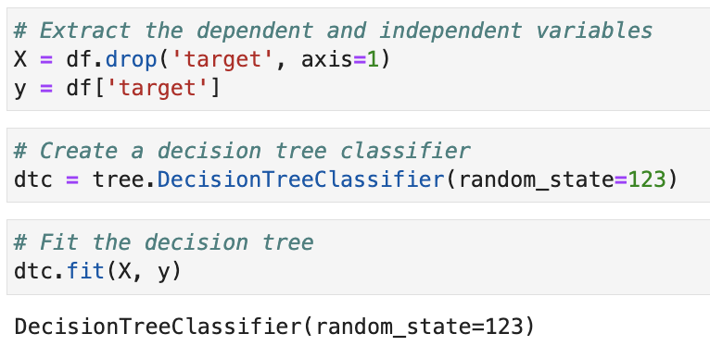
Activity (Answers)

Slide 54
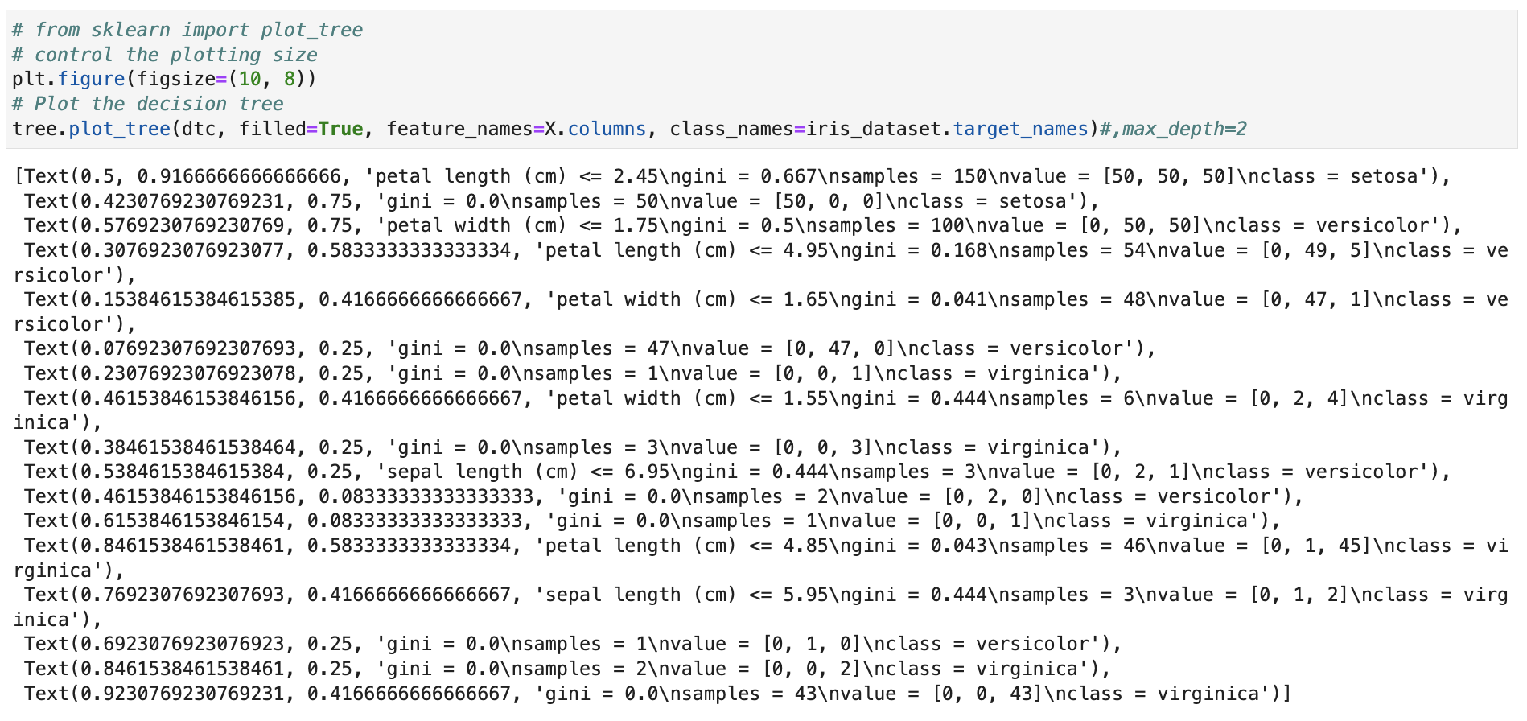
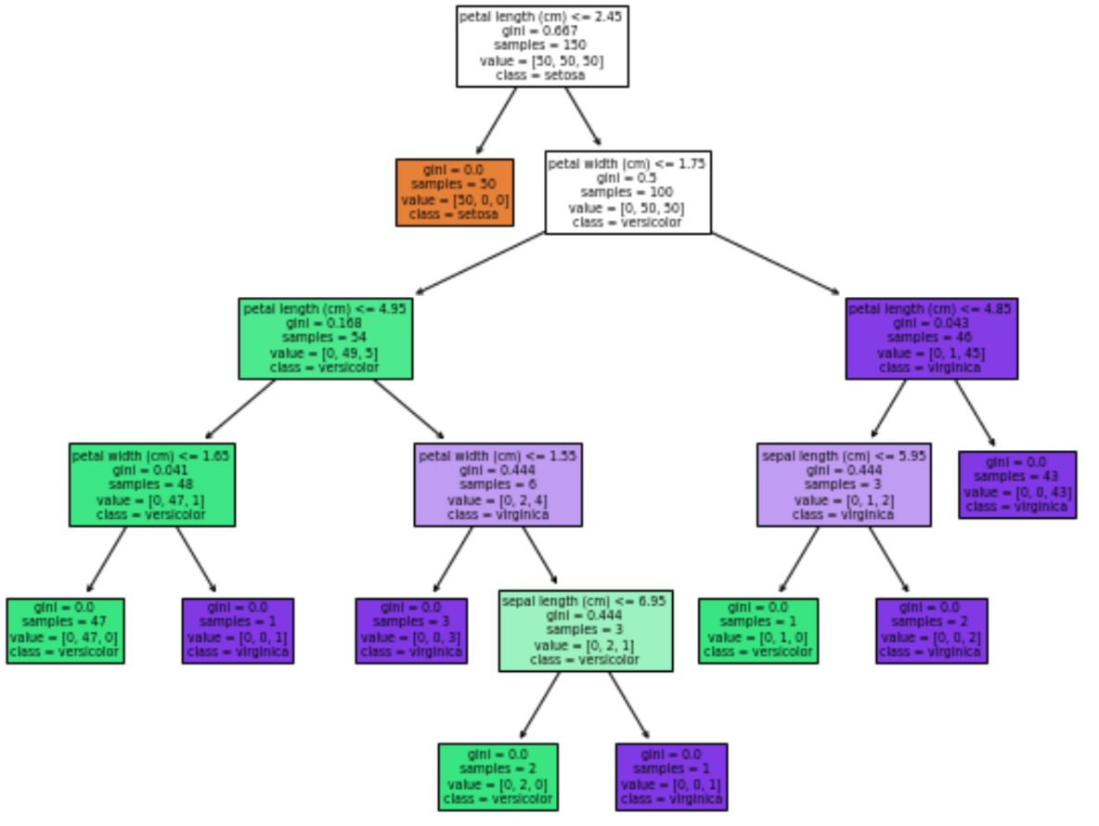
Activity (Answers)

Slide 55
Discussion
Name all the main differences between classification trees and regression trees.

Slide 56
Discussion (answers)
Name all the main differences between classification trees and regression trees.
Classification: binary / categorical target; regression: continuous target

Slide 57
Online Learning Platform (Optional)
Decision Tree:
https://www.w3schools.com/python/python_ml_decision_tree.asp
K-means Clustering:
https://www.w3schools.com/python/python_ml_k-means.asp

